Slide 1
Intentional Communication is
an Art Form

Slide 2
Saying What You’re NOT Saying- Message Clear & Memorable
Betrayed by Body Language?
60%
Avoiding Eye Contact
Wrinkled Forehead
Foot Tapping
Crossed Arms
Tightly pinched mouth
Intentional Gestures Send Signals that Match the Message
Ramsey, Robert D. (2009). How to Say the Right Thing Every Time: Communicating Well with Students, Staff,
Parents and the Public. Corwin Press: Thousand Oaks, CA

Slide 3


Saying What You’re NOT Saying- Message Clear & Memorable
Open Arms
Relaxed Stance
Moving Closer
Leaning Forward
Touching
Flaring Nostrils
Adjusting Clothes
Leaning Backward
Lowered Eyes
Hands on Hips
Positive Gestures
Negative Gestures
Ramsey, Robert D. (2009). How to Say the Right Thing Every Time: Communicating Well with Students, Staff,
Parents and the Public. Corwin Press: Thousand Oaks, CA

Slide 4

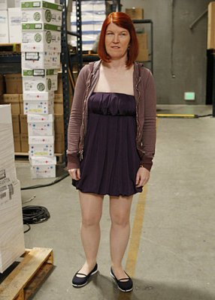


Saying What You’re NOT Saying- Trustworthy Appearance
Psychological Constructs
Unmeasurable variables
Attitudes, personality traits, emotional states, abilities
Unspoken dress code
Aesthetic presentation
Credibility
Acceptance
Authority
respect
Degroot, T., & Gooty, J. (2009). Can nonverbal cues be used to make meaningful personality attributions in employment interviews? Journal of Business and Psychology, 24(2), 179-192. Wong, H. K., & Wong, R. T. (1998). The First Days of School: How to Be an Effective Teacher. Chicago

Slide 5

Saying What You’re NOT Saying- Build Relationships
listening
modeling
Confidentiality
Mutual support
Nolan, James F, and Hoover, Linda A. (2011) Teacher Supervision and Evaluation: Theory Into Practice. 3rd Ed. John Wiley and Sons: River Street, Hoboken. Kay, Mary (2015) Why Employees Don’t Speak Up. About Leaders Website.

